Slide 1
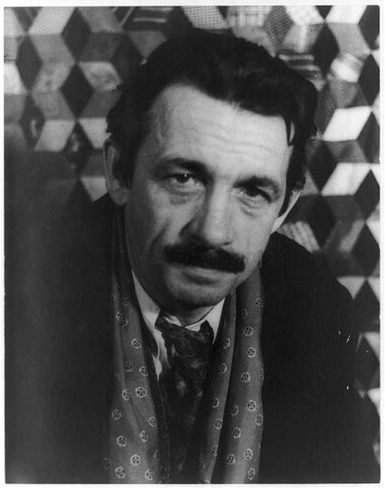
Thomas Hart Benton
(April 15, 1889 – January 19, 1975)
an American painter & muralist.

Slide 2
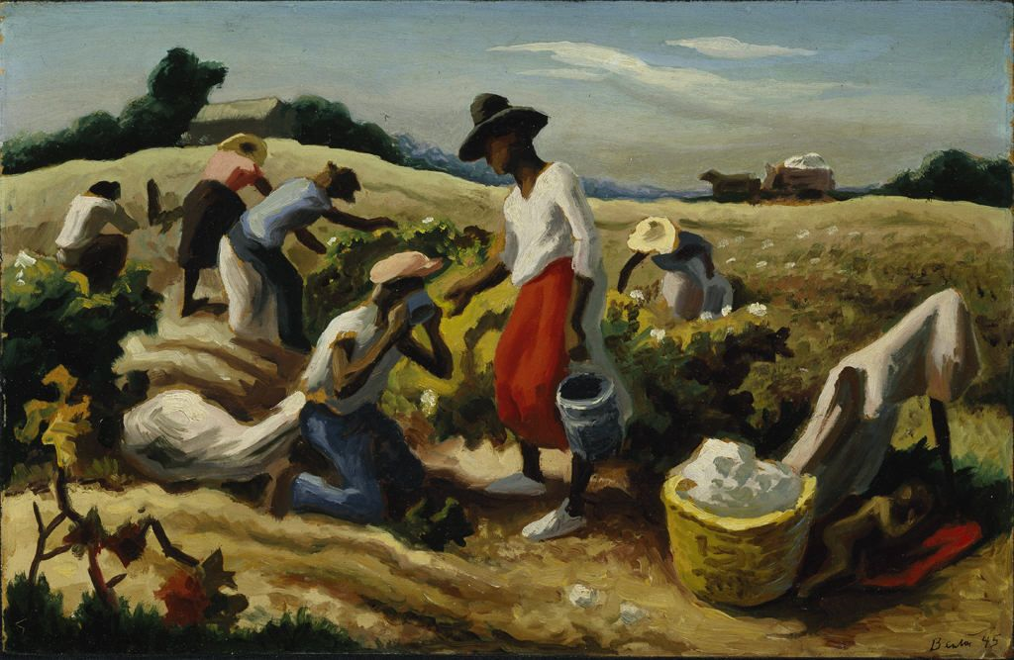
Thomas Hart Benton
Field Workers (Cotton Pickers)
1945
Oil on canvas

Slide 3
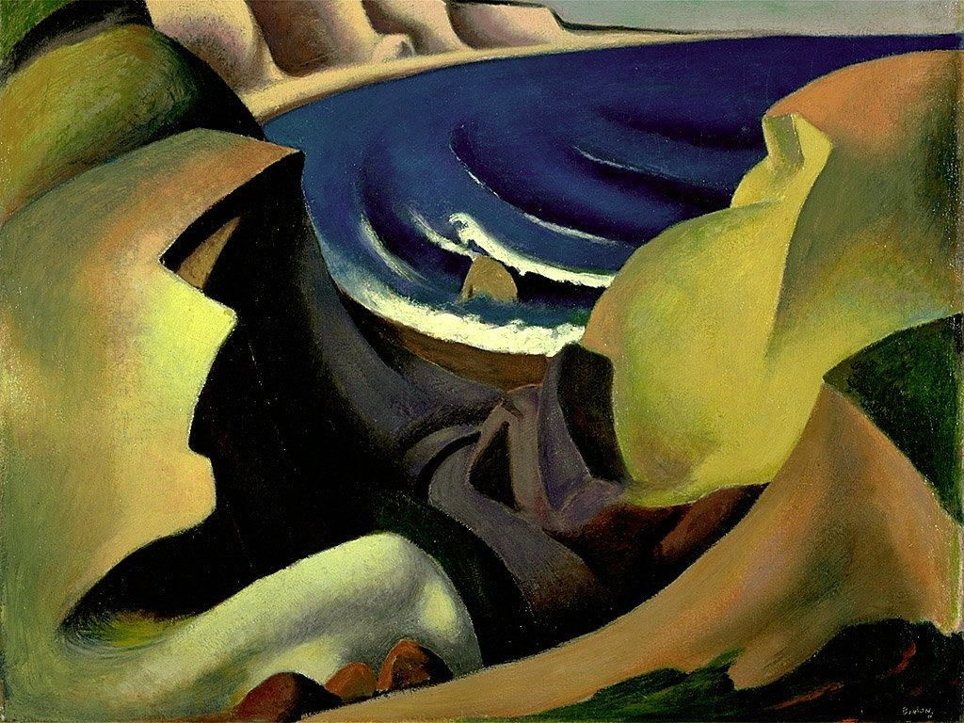
Thomas Hart Benton
The Cliffs,
1921
Oil on canvas

Slide 4
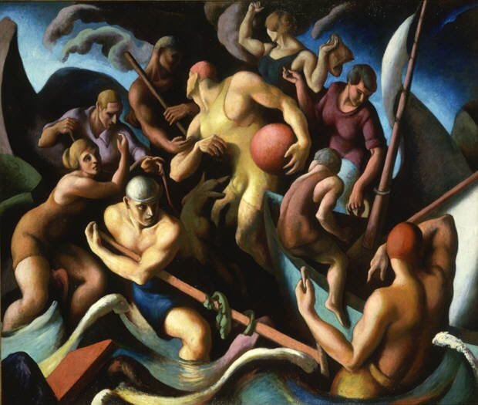
Thomas Hart Benton
People of Chilmark (Figure Composition)
(1920)
Oil on canvas

Slide 5
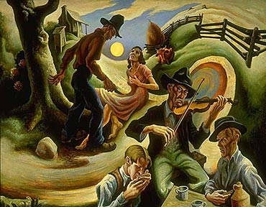

Slide 6
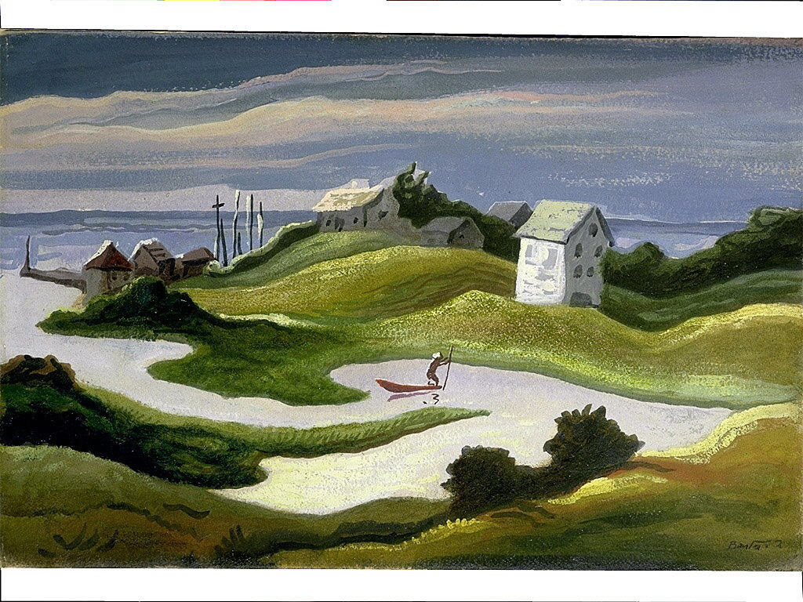
Thomas Hart Benton
Chilmark Landscape
1922
Oil on paper mounted on fiberboard

Slide 7
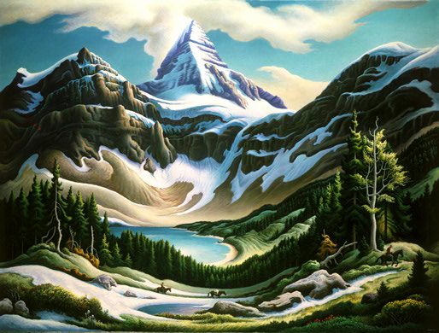
Thomas Hart Benton Trail Riders
1964/1965

Slide 8
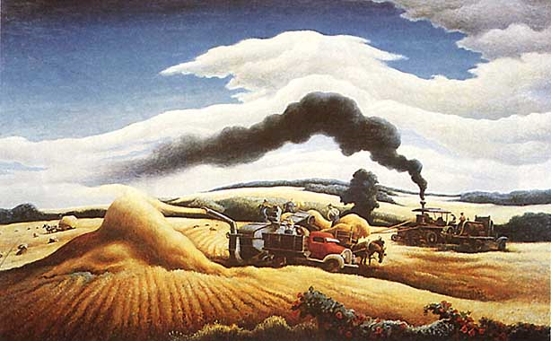

Slide 9
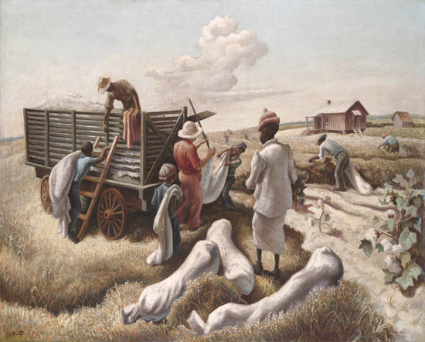
Thomas Hart Benton
Weighing Cotton

Slide 10
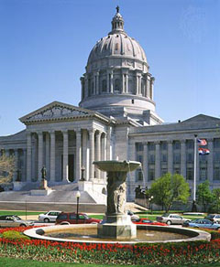
Missouri State Capitol Building

Slide 11
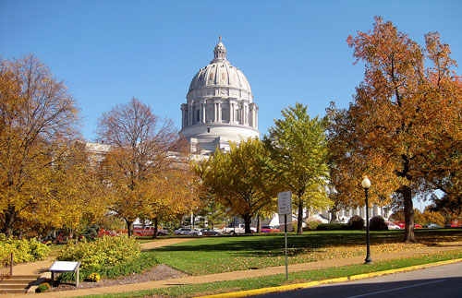
Missouri State Capitol Building

Slide 12
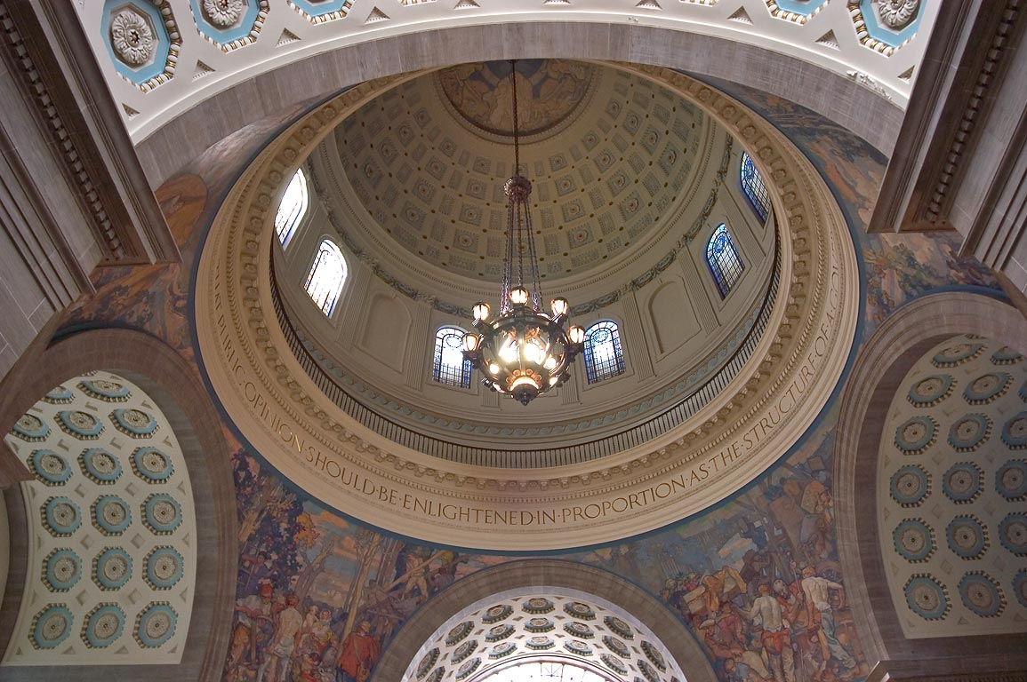
Thomas Hart Benton
Missouri State Capitol Building

Slide 13
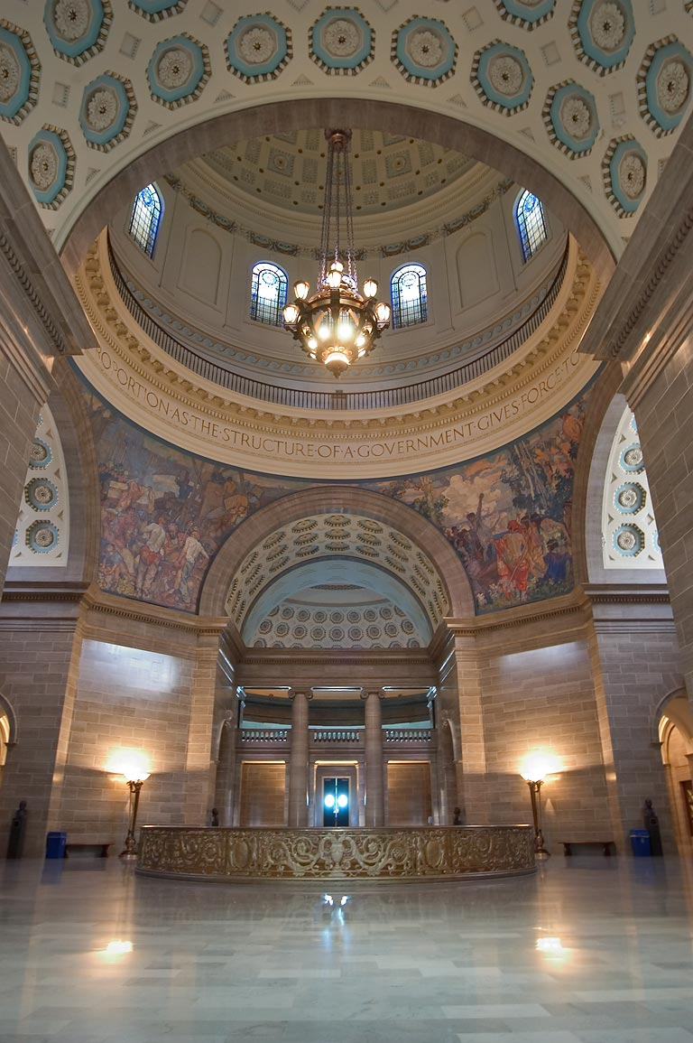
Thomas Hart Benton
Missouri State Capitol
Building

Slide 14
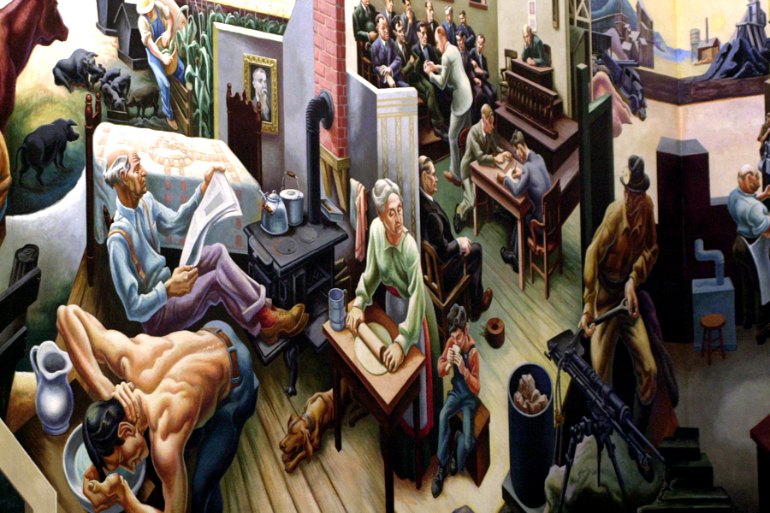
"A Social History of Missouri," located on the third floor of the State Capitol in the House Lounge.

Slide 15
